Slide 1
pointers

Slide 2
What is a variable?
?

Slide 3
What is a variable?
A name for a piece of memory
Holds a value
Variables are instantiated
A free memory address is assigned to the variable
Any value we assign to that variable is stored in the memory address

Slide 4
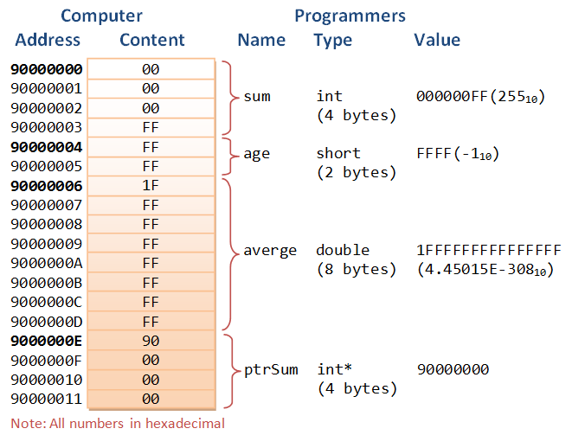

Slide 5
pointers
Hard
Powerful
C# and Java both removed them – they are hard to use
Memory leaks
Stack overflows

Slide 6
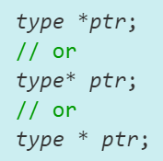
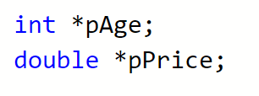
Pointer declaration
A pointer is a variable
It stores a memory address

Slide 7
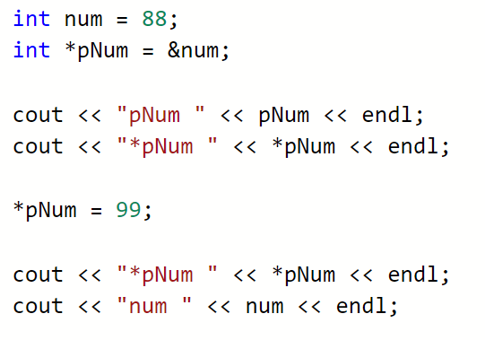
Address of operator &
Pointers are not initialized
Assign to something – usually with the & address of operator
Only on the RHS of assignment operator

Slide 8
Dereferencing operator - *
Indirection operator
or
Dereferencing operator
*
Operates on a pointer
Returns the value stored in that address

Slide 11
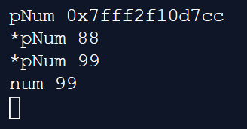

Slide 12
0x7fff2f107ff
0x7fff2f107cc
0x7fff2f107cc
88
pNum
num

Slide 13
Pointer info
Indirect referencing
Dereference can be used on LHS and RHS of assignment
  tmp = *pNum
  *pNum = tmp
Pointers have a type. A pointer to an int can only point to integers.

Slide 14
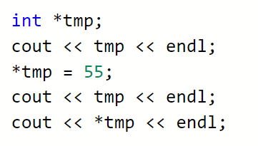

Uninitialized pointers
Declared
No initialized (points where?)
Most c++ compilers don’t care
Clang:

Slide 15
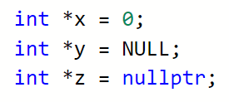
Null pointers
Assign the pointer to 0 or NULL
Dereferencing a null pointer causes an STATUS_ACCESS_VIOLATION exception

Slide 16
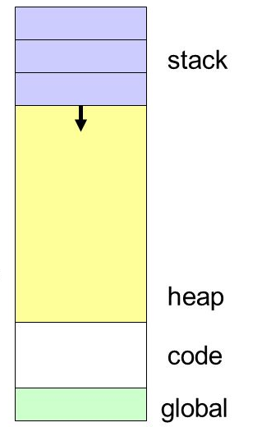
4 major memory segments
Code – the compiled code
Heap – dynamically allocated variables
Stack – parameters, automatic and temporary variables
Global – variables not in the stack or heap

Slide 17
Work
Make sure you are aware of how memory is used in c++
Stack, heap
https://slideplayer.com/slide/8303747/
Finish writing functions for worksheet 1
Investigate the c functions - malloc, realloc and free

